Slide 1
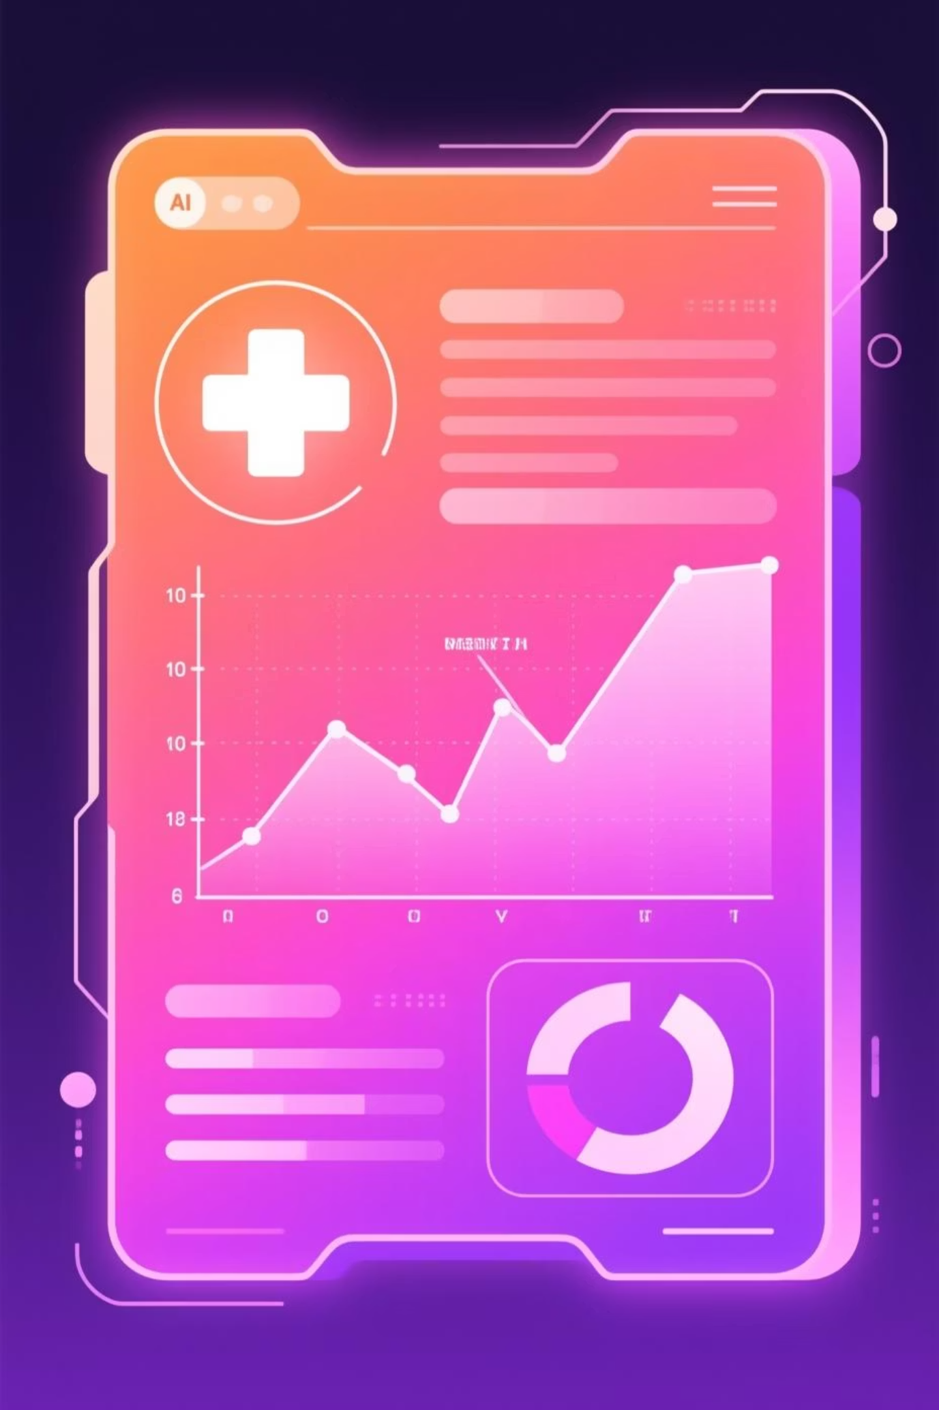
MediScan AI
An Intelligent System for Simplified Medical Report Interpretation
By: Jaychandra Das & Mihir Parida
Empowering patients through understandable healthcare insights

Slide 2

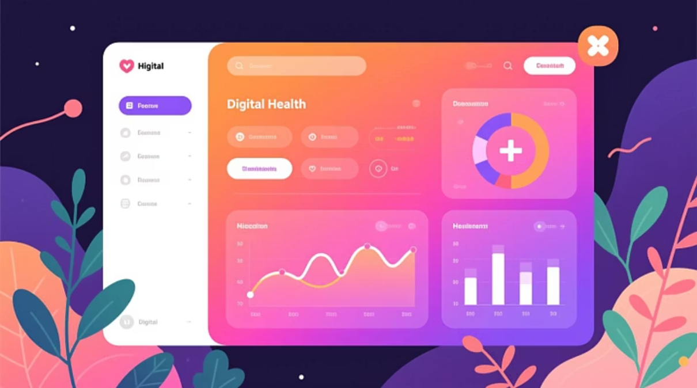
INTODUCTION
Medical reports often contain complex data difficult for patients to interpret. MediScan AI analyses test results (like blood tests) and presents them in simple, human-understandable language.
Patient Empowerment
Transparent Information
Enables users to make informed health decisions without needing deep medical knowledge.
Assists doctors, patients, and healthcare platforms in delivering accessible and clear information.

Slide 3




Key Objectives of MediScan AI
Automatic Analysis
Detect Risks
Develop an AI tool for automatic analysis of medical reports.
Detect abnormalities and highlight potential health risks in test results.
Digital Accessibility
Doctor Support
Promote digital healthcare accessibility, especially in rural areas.
Support doctors with quick preliminary analysis for improved efficiency.
The goal is to provide clear, patient-friendly summaries of complex data.

Slide 4





Methodology: From Data to Explanation
Data Collection
Medical datasets (test values, reference ranges) used for model training.
Preprocessing
Standardizes test names, normalizes ranges, and cleans raw data.
AI Model
Uses machine learning and rule-based reasoning to interpret results.
Language Generation
Converts numerical data into meaningful, simple explanations.
Visualization
Presents results through a clean, interactive user interface.

Slide 5
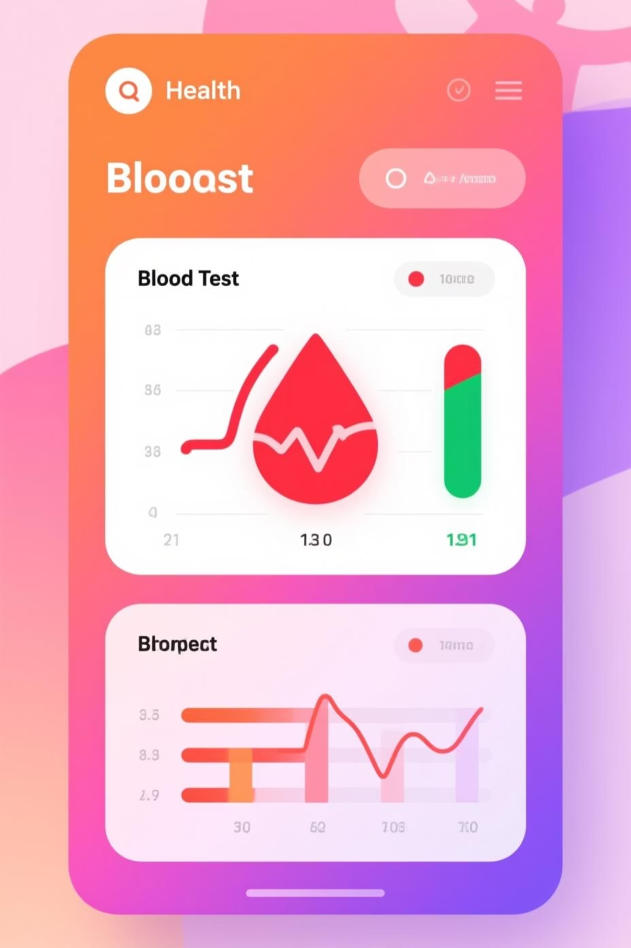
Interpreting a Blood Test Report
The system takes a sample blood test report as input and provides a simplified, actionable explanation.
Input Example:
AI Output (Simplified Explanation):
Hemoglobin: 10.8 g/dL (Low)
“Your hemoglobin level is slightly low, which may indicate fatigue or anemia. Glucose is within the normal range, but your cholesterol level is high — consider a balanced diet and exercise.”
Glucose: 98 mg/dL (Normal)
Cholesterol: 220 mg/dL (High)

Slide 6
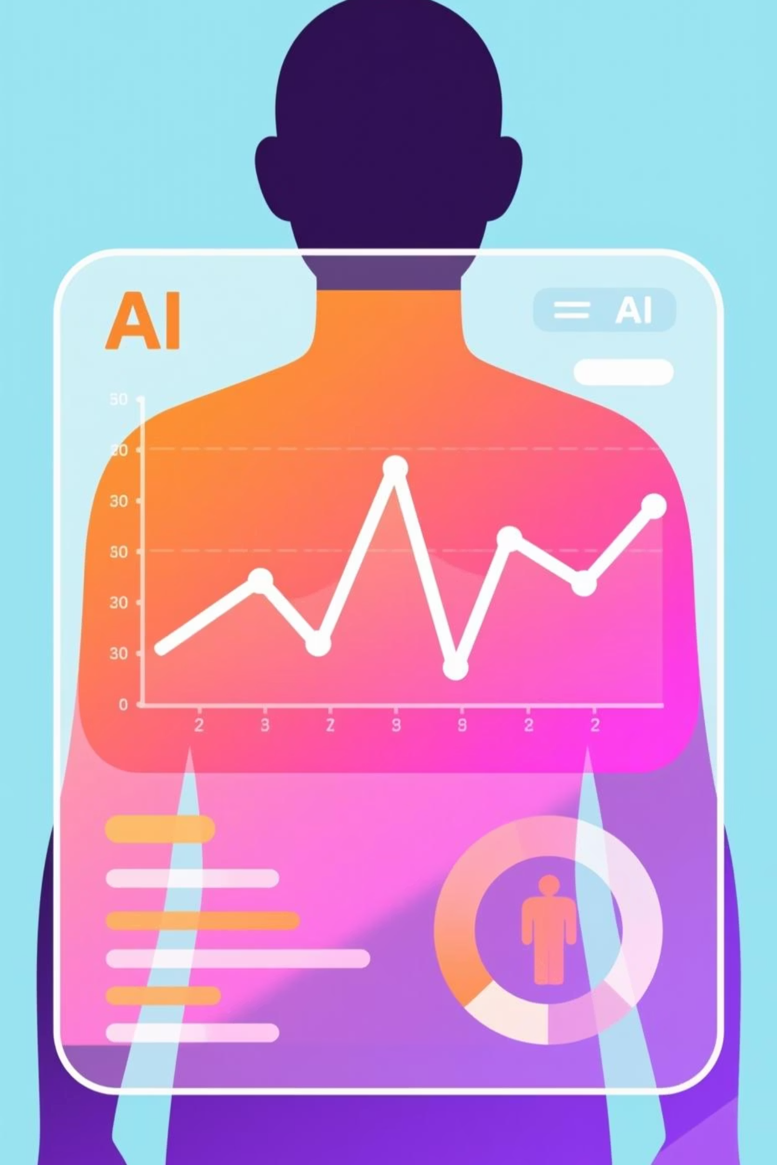

Conclusion and Next Steps
MediScan AI demonstrates how AI can transform healthcare accessibility, reducing patient confusion and dependency.
Integration Potential
Strong potential for integration into hospitals, telemedicine platforms, and diagnostic centers.
Future Evolution
Can evolve into a complete AI health assistant, predicting diseases and providing lifestyle recommendations.
MediScan AI — Because understanding your health should be simple.

